Slide 1
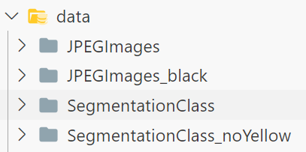



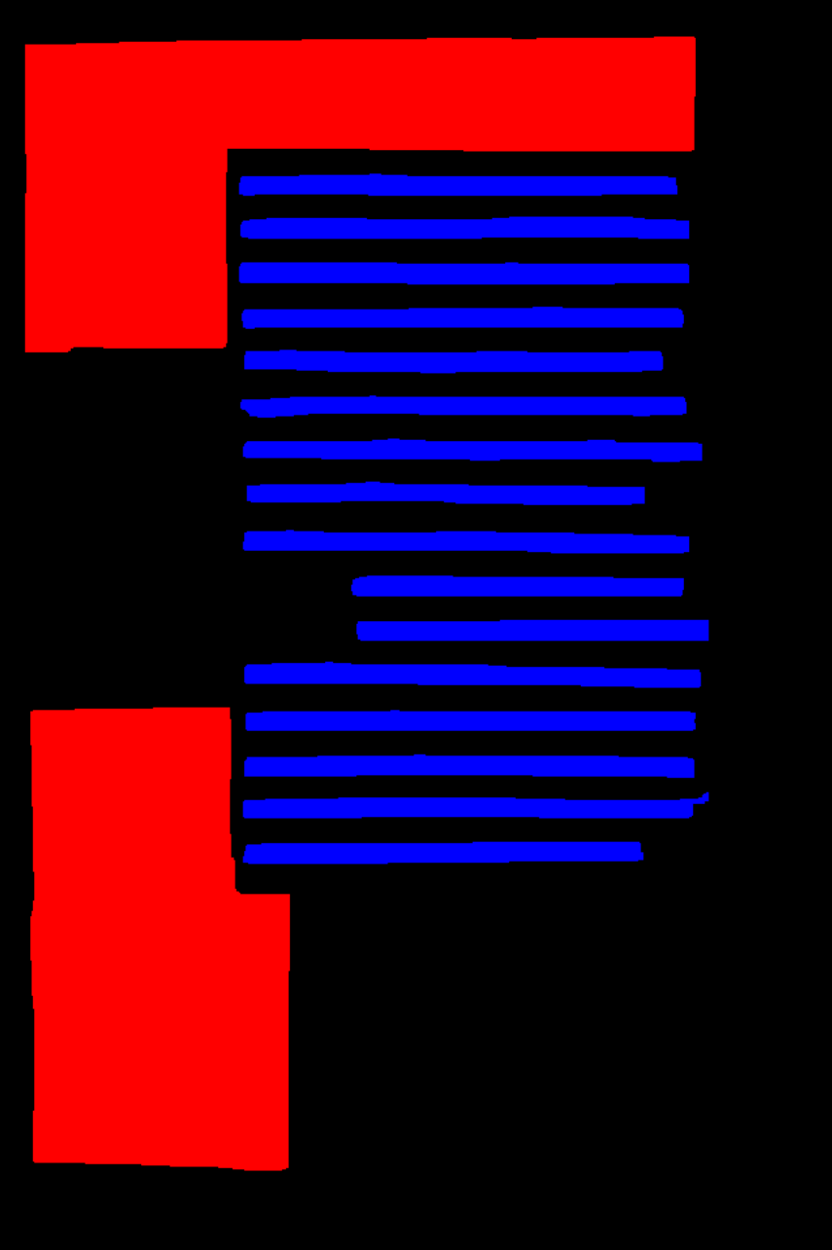
Dataset reprocess

Slide 2
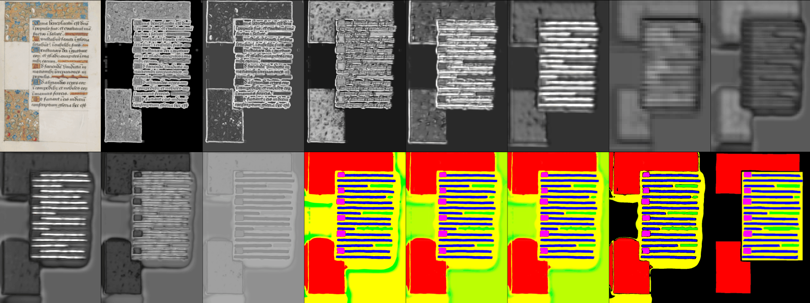
Dataset reprocess

Slide 3
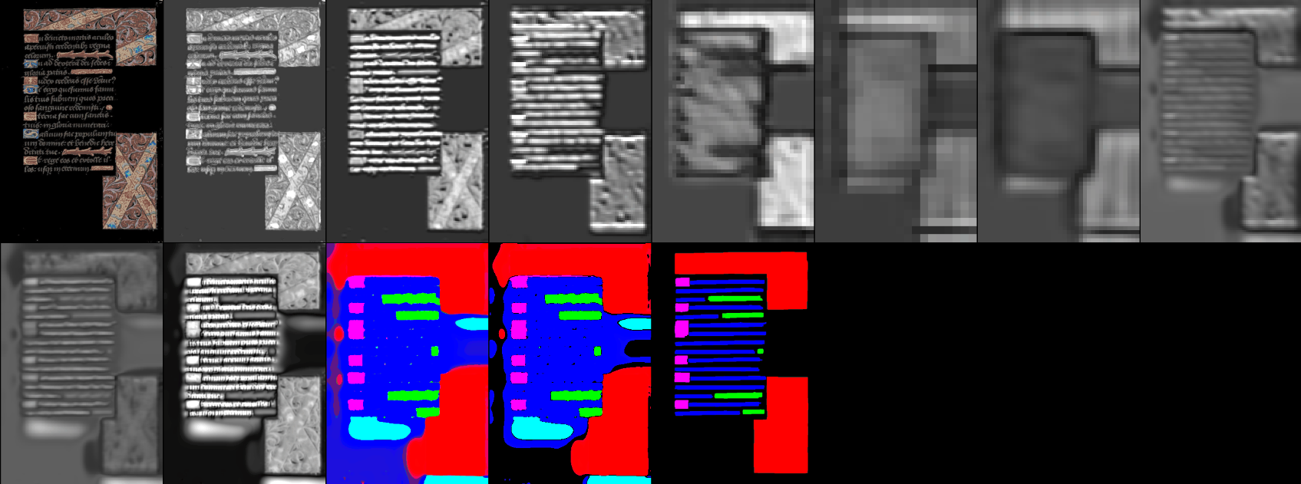
Dataset reprocess

Slide 4
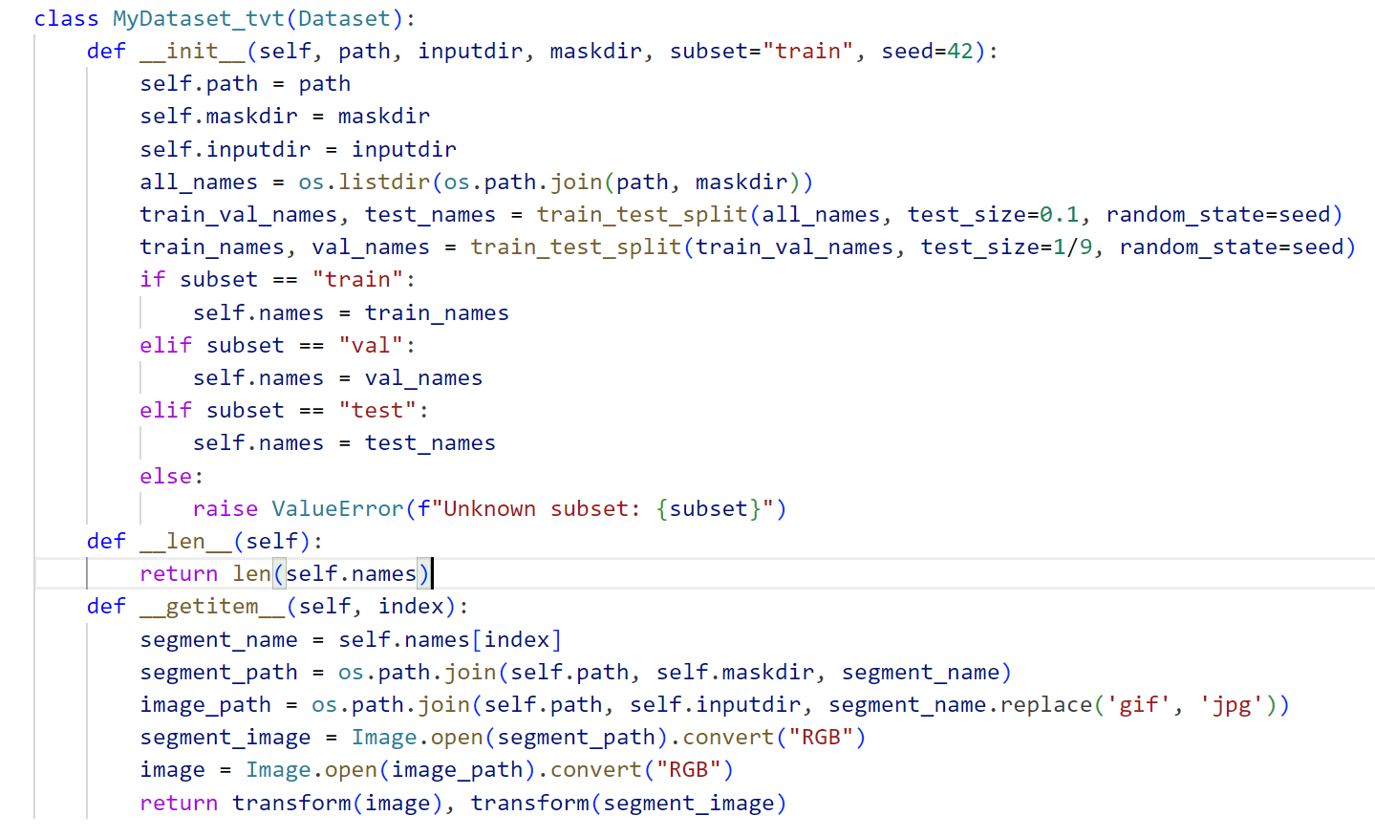
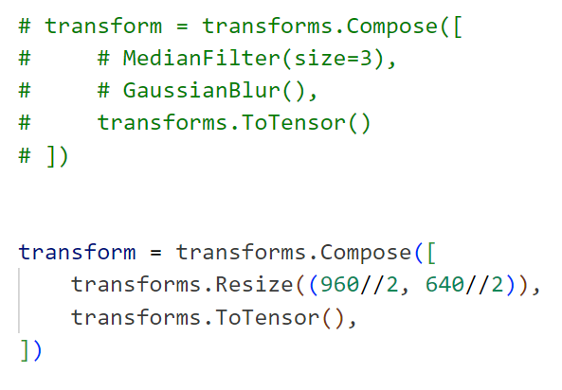
Dataset and Dataloader

Slide 5
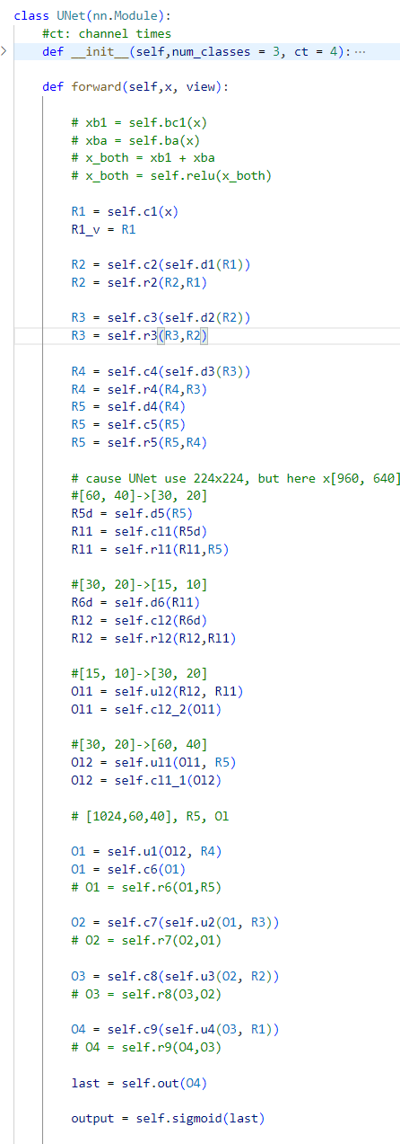
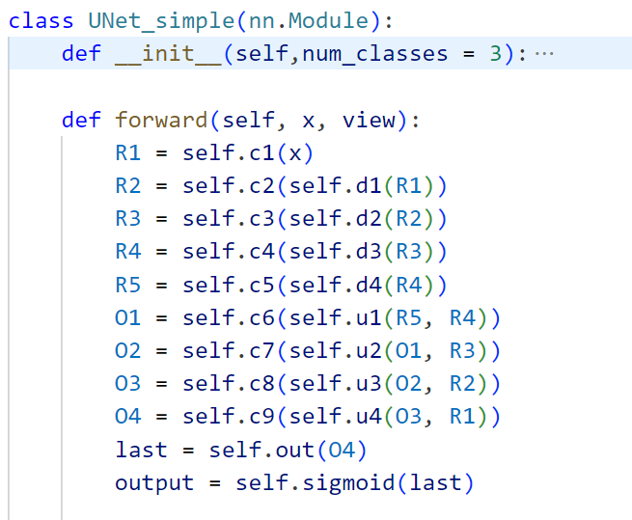
Model
and maybe other module, depend on matric result

Slide 6
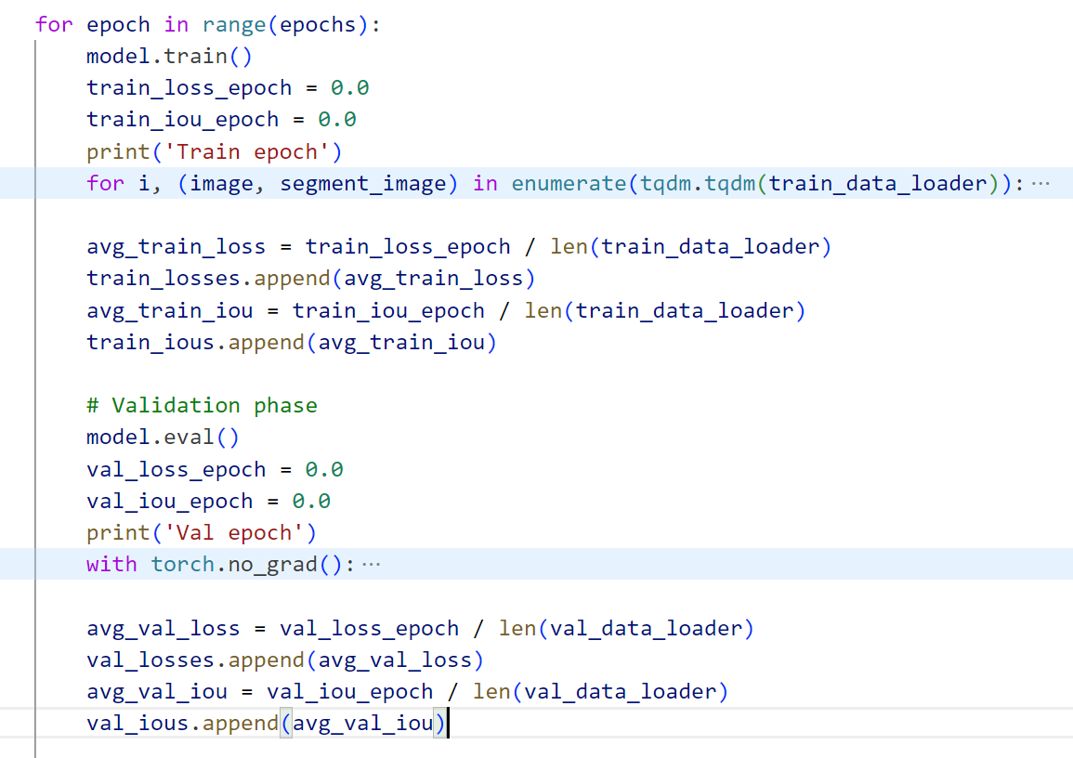
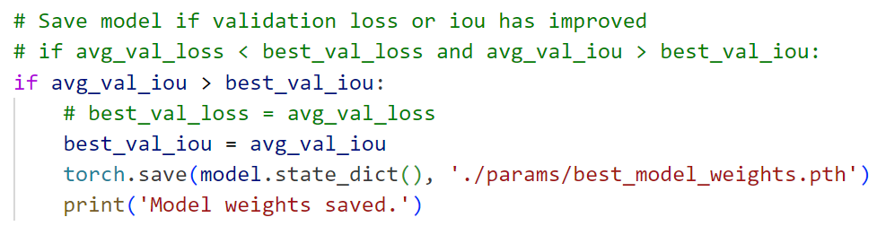
Training process

Slide 7
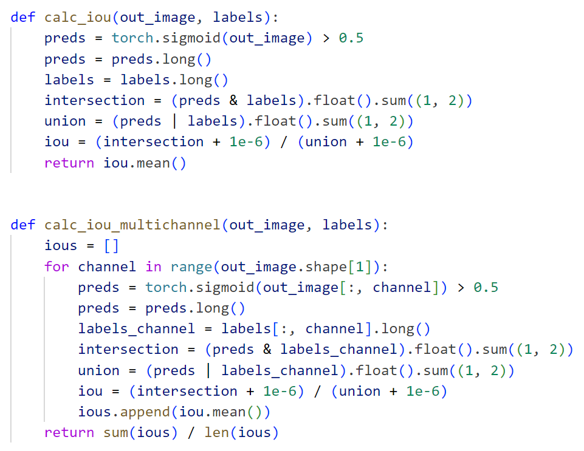
Matrics

Slide 8
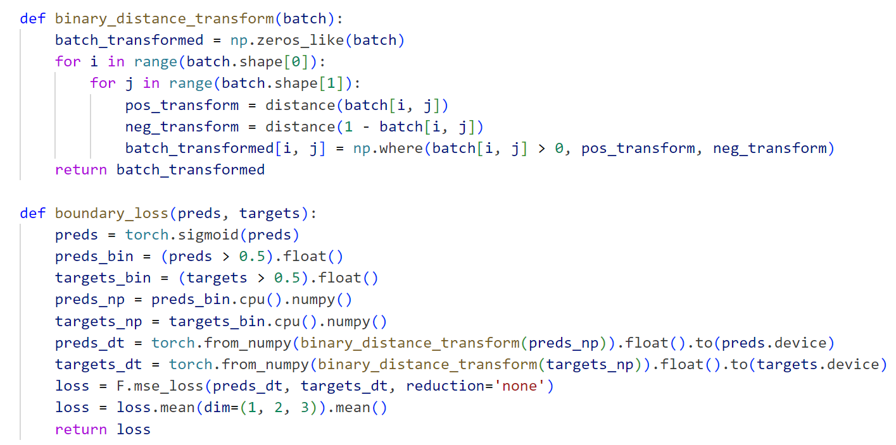
Matrics
“Boundary Loss aims to enhance the accuracy of boundary prediction in image segmentation tasks, especially in applications that require precise boundary localization, such as medical image segmentation. It works by emphasizing the differences between boundary pixels as a way to improve segmentation quality.”

Slide 9
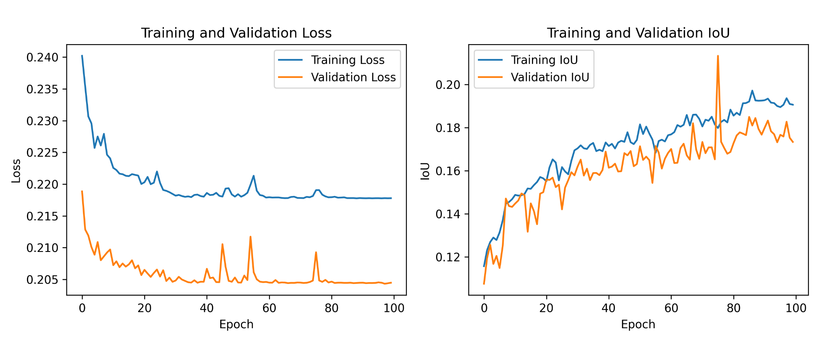
Demo visualization

